Slide 1
Mapping Synthesizers to Real-World Instruments
Landon Buell
4 Dec 2020

Slide 2
Let’s Play a Game
What made the sound being played?

Slide 3

Name the Source of the Sound
Example 1:
Violin – G4
Example 2:
Guitar – B2
Example 3:
Clarinet – G#5
Example 6:
Oboe – Bb4

Slide 4
How do you Know?
Humans good at mapping sounds to sources
Can we “teach” a computer to do it?
Practical Example: Classifying Synthesizers

Slide 5
The Neural Network
Introduction / Function / Training

Slide 6
Neural Network?
“Birds inspired us to fly, burdock plants inspired velcro and nature has inspired many other inventions. It seems only logical, then, to look to the brain’s architecture for inspiration on how to build an intelligent machine.”
- Aurelion Geron, Former Youtube Video Classification lead

Slide 7
What is a Neural Network?
A Neural network is a mathematical function
Composed of Layers, with “trainable” Parameters
Transform an Input Array into an Output Array

Slide 8
A Classification Model
We map a set of inputs to a qualitative output
We seek to “group” similar inputs
This model is called a classifier

Slide 9
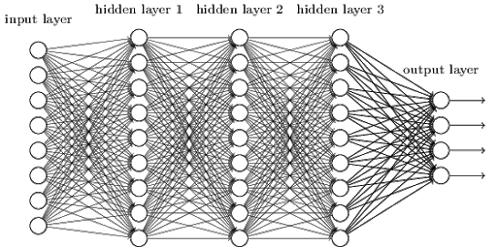
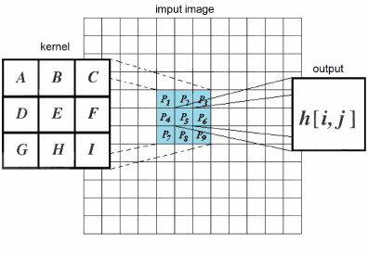
Main Types of Layers
Dense Layer
2D Convolution Layer
“Dense” Connectivity
Outputs are a linear combination of inputs
“Sparse” Connectivity
Outputs are inputs convolved with a weighting kernel

Slide 10

Training A Network
Provide the model with labeled training samples
We quantify the error with an Objective Function
Choose the parameters that minimize the objective function

Slide 11
Optimization
Iterative method based on gradient descent
Do we Train a Neural Network?
Do we Optimize a Neural Network?

Slide 12
Features Used
Spectrogram / Time-Series / Frequency Series

Slide 13
How are Features Chosen?
“For recognition algorithms, the necessary property of the acoustic features is low variability among features extracted from examples assigned to the same class, and at the same time high variability allowing distinction between features extracted from examples assigned to different classes”
- Tuomas Virtanen, Machine Learning & Audio Engineer

Slide 14
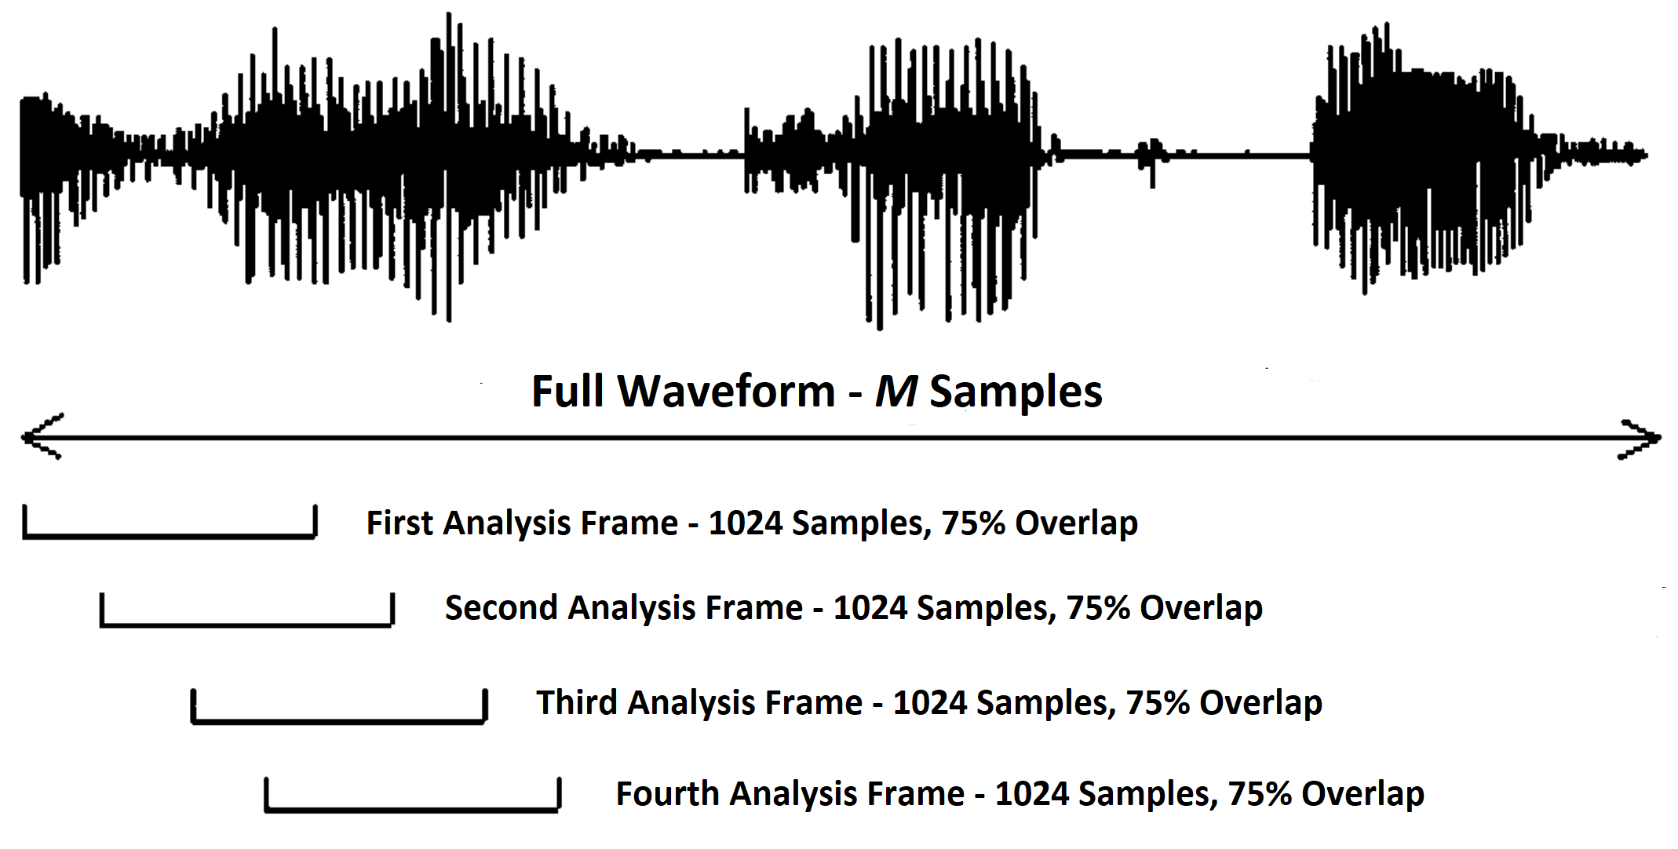
Analysis Frames
“Preprocessing” Step
Examine waveform in a “Quasi- Stationary state”

Slide 15
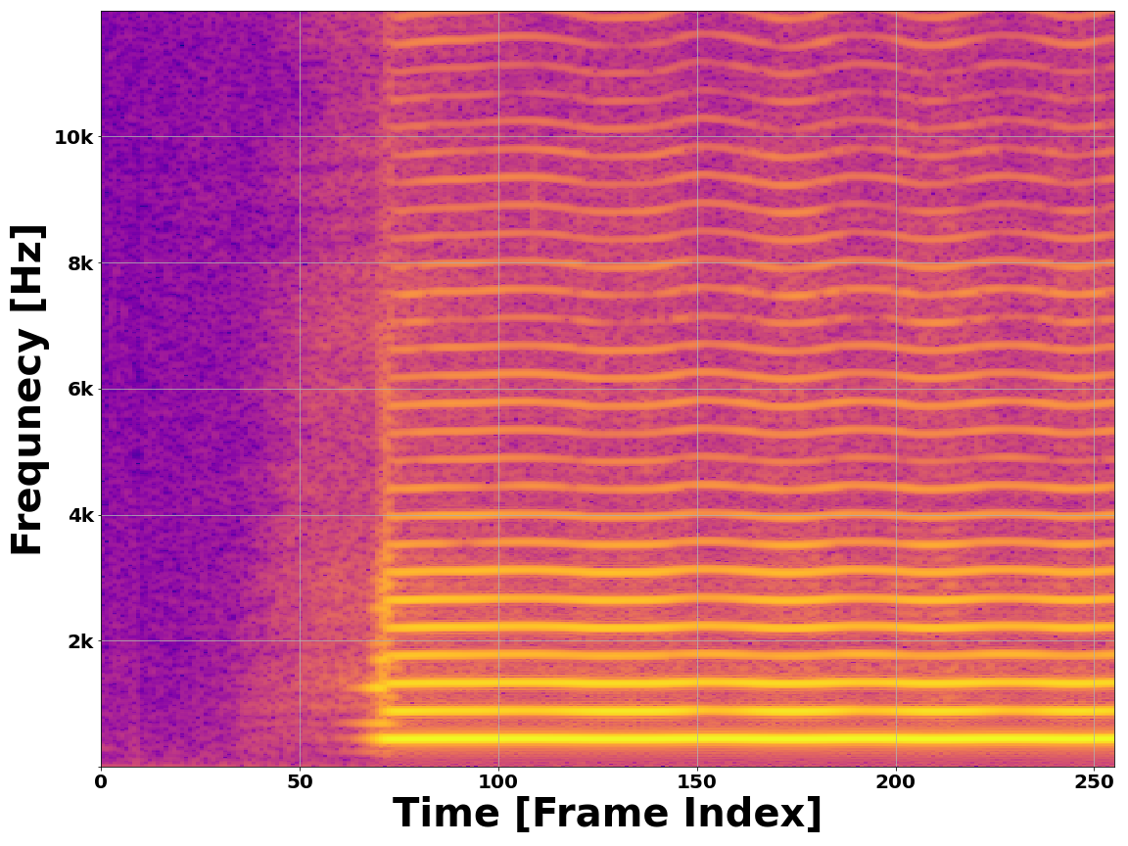
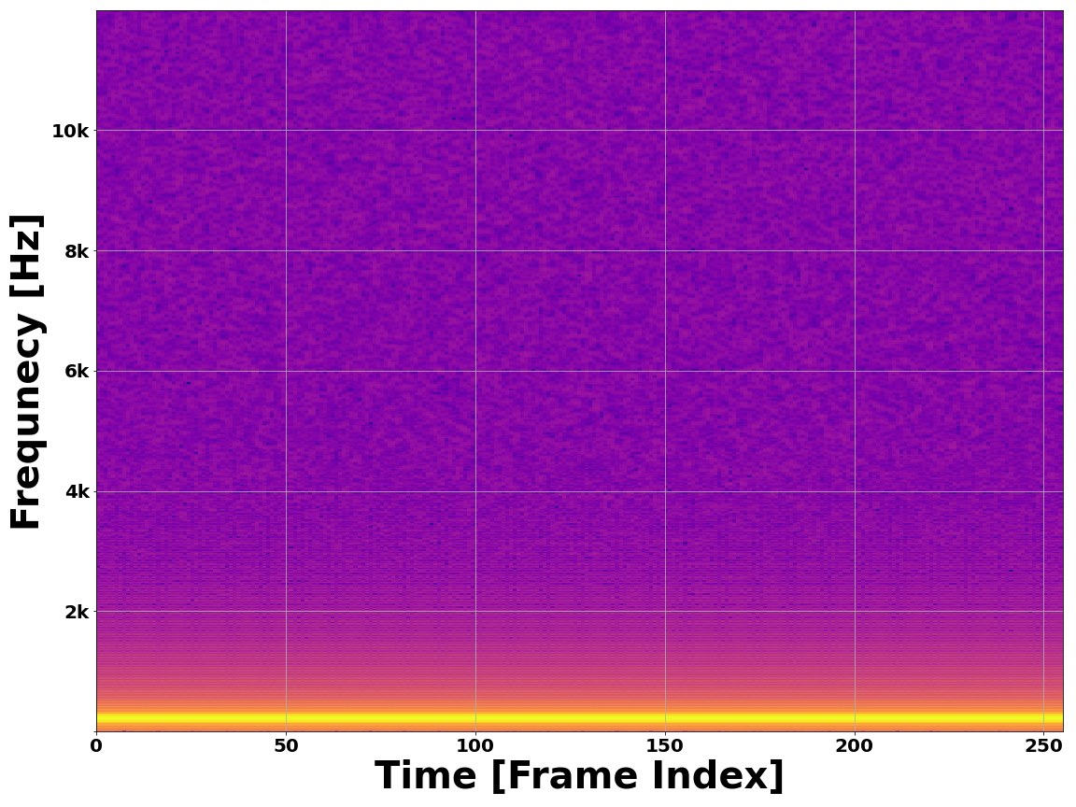
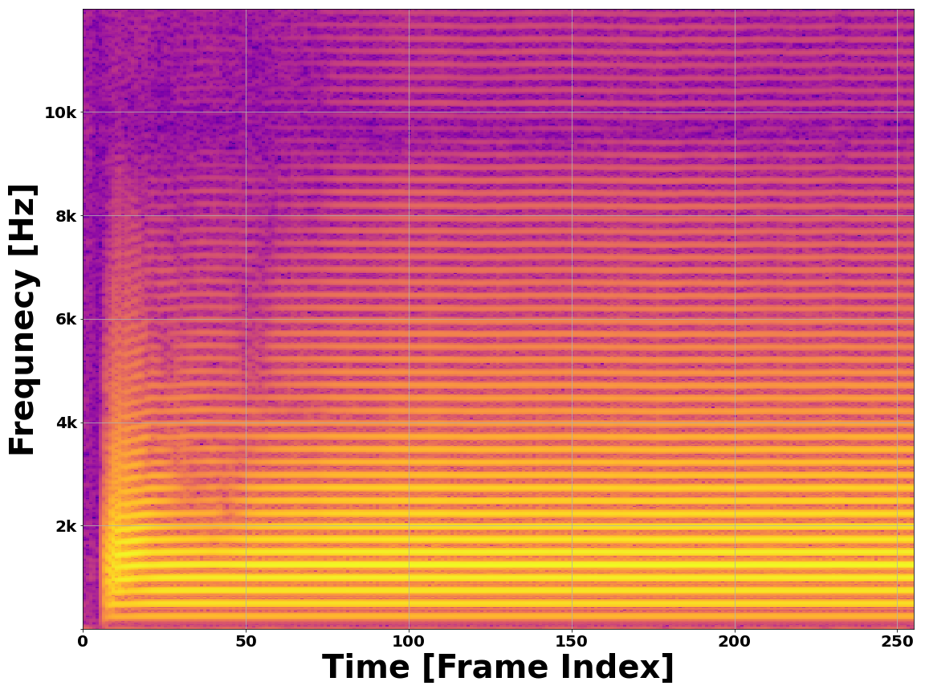
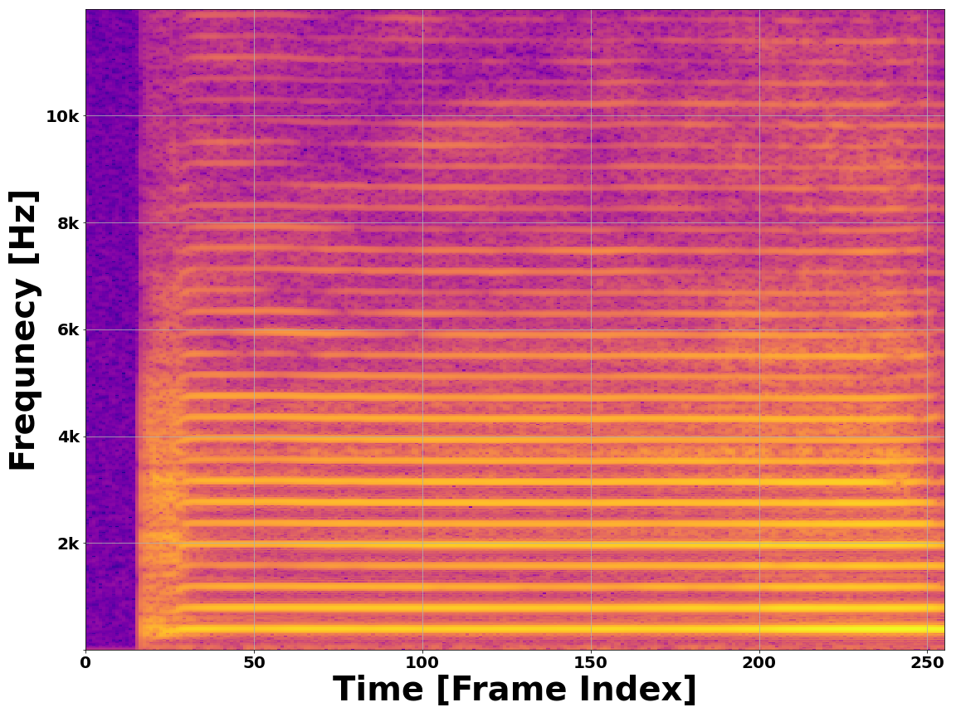
The Spectrogram
Provides a 2D image-like representation of a waveform
Maps energy over frequency and time
Time passes on X-axis
Frequency on Y-axis
Alto Saxophone – A4
Pure Sine – 220 Hz
Bb Trumpet – B3
Violin – G4

Slide 16
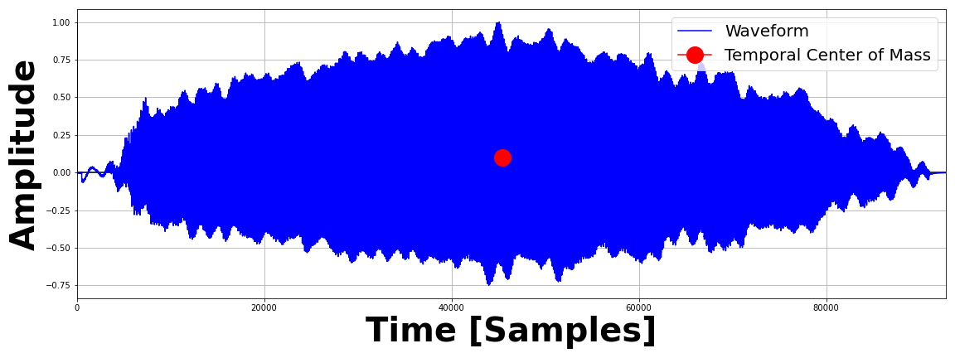
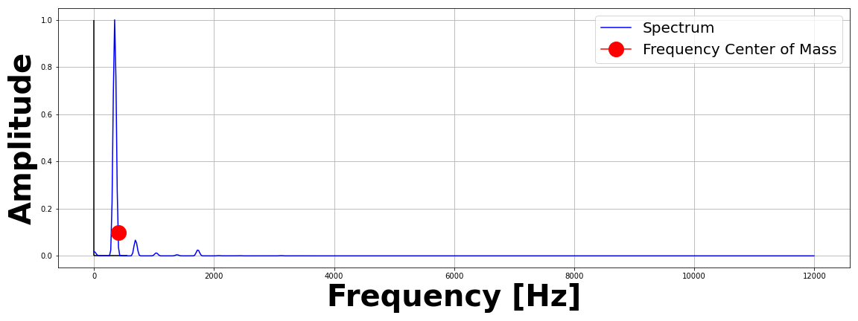
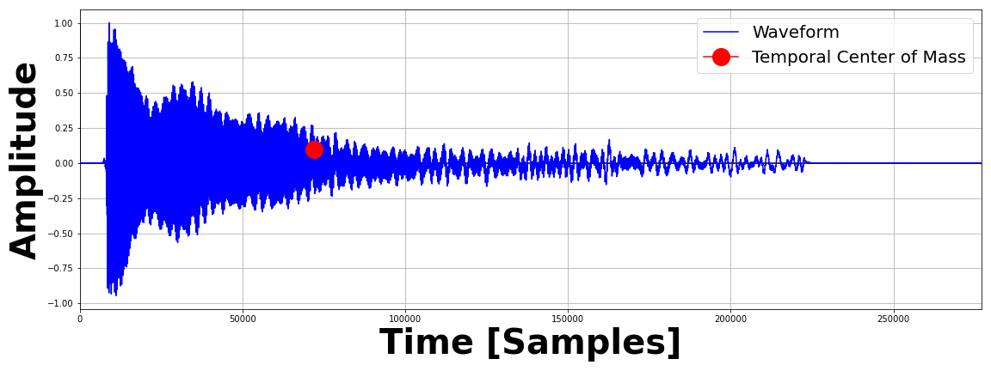
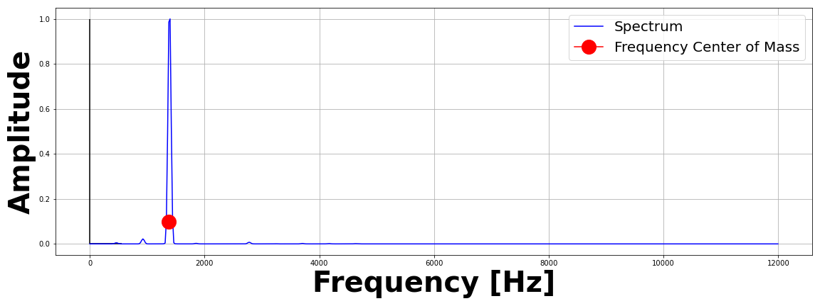
The Feature Vector
Time Center of Mass
Frequency Center of Mass

Slide 17
Feature Vector (Cont.)
Mel Frequency Cepstrum Coefficients
Time Domain Envelope

Slide 18
Network Architecture
What do we do with our features?

Slide 19
Dual Modalities
2D Spectrogram vs. 1D Feature Vector
Two modes – convey the same information
Compare to human cardinal senses

Slide 20
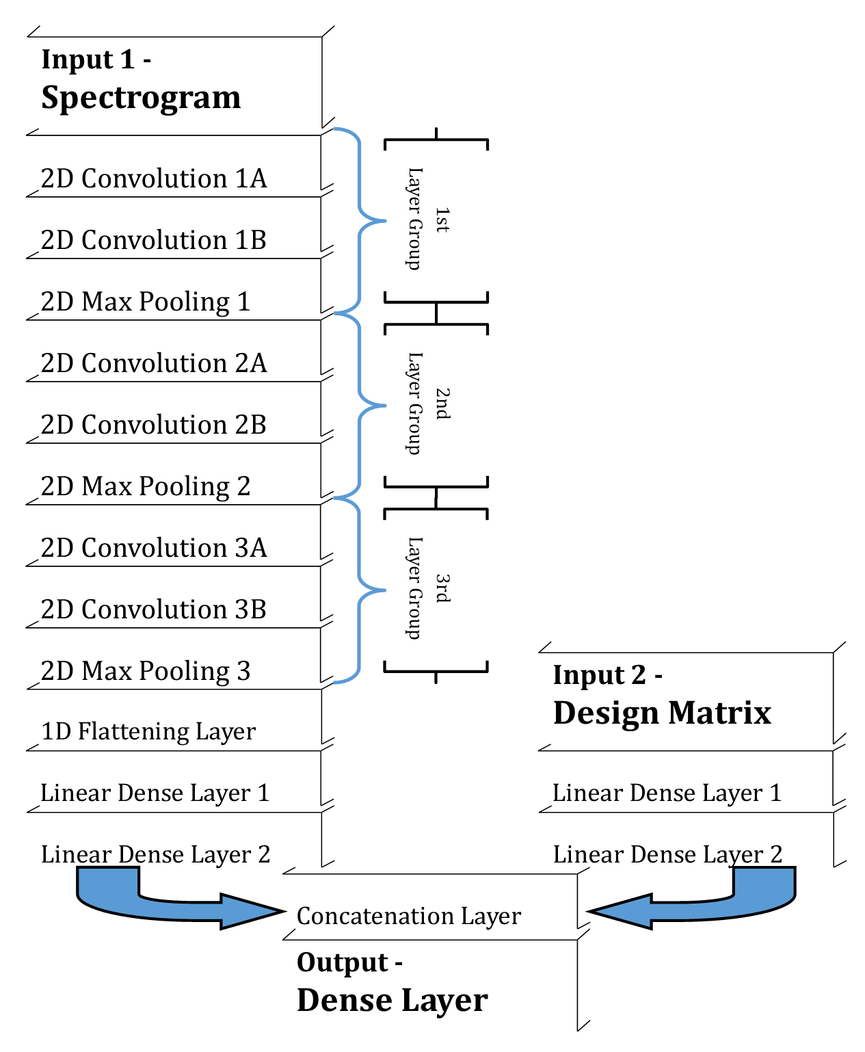
A Hybrid Neural Network
Image is Processed with a Convolutional Neural Network
Vector is Processed with a Mulitlayer Perceptron
Results are Merged to form a single prediction based on both inputs

Slide 21
Does it Work?
Can we trust the model?

Slide 22
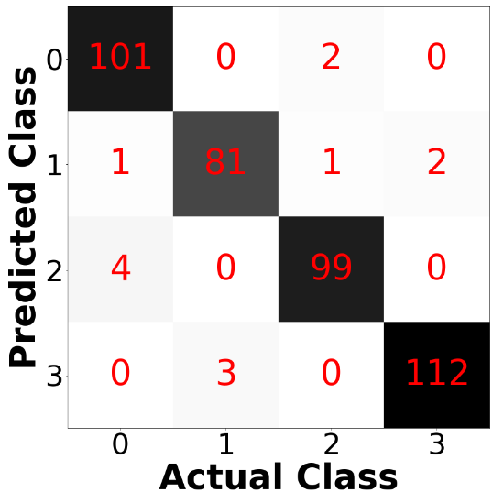
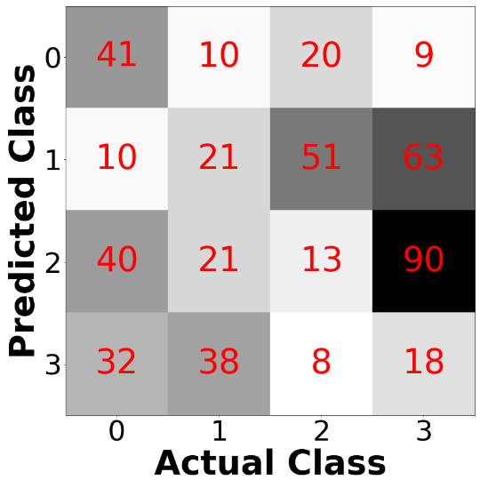
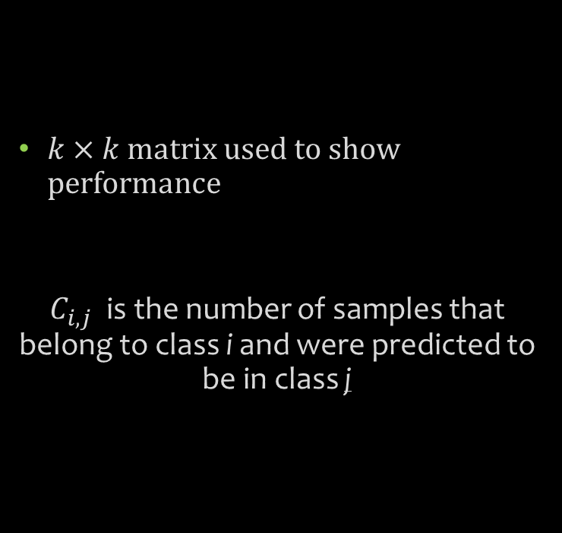
The Confusion Matrix
$k×k$ matrix used to show performance
$C_{i,j}$ is the number of samples that belong to class i and were predicted to be in class j
Diagonal dominance indicates
a stronger model
No diagonal dominance indicates
a weaker model

Slide 23
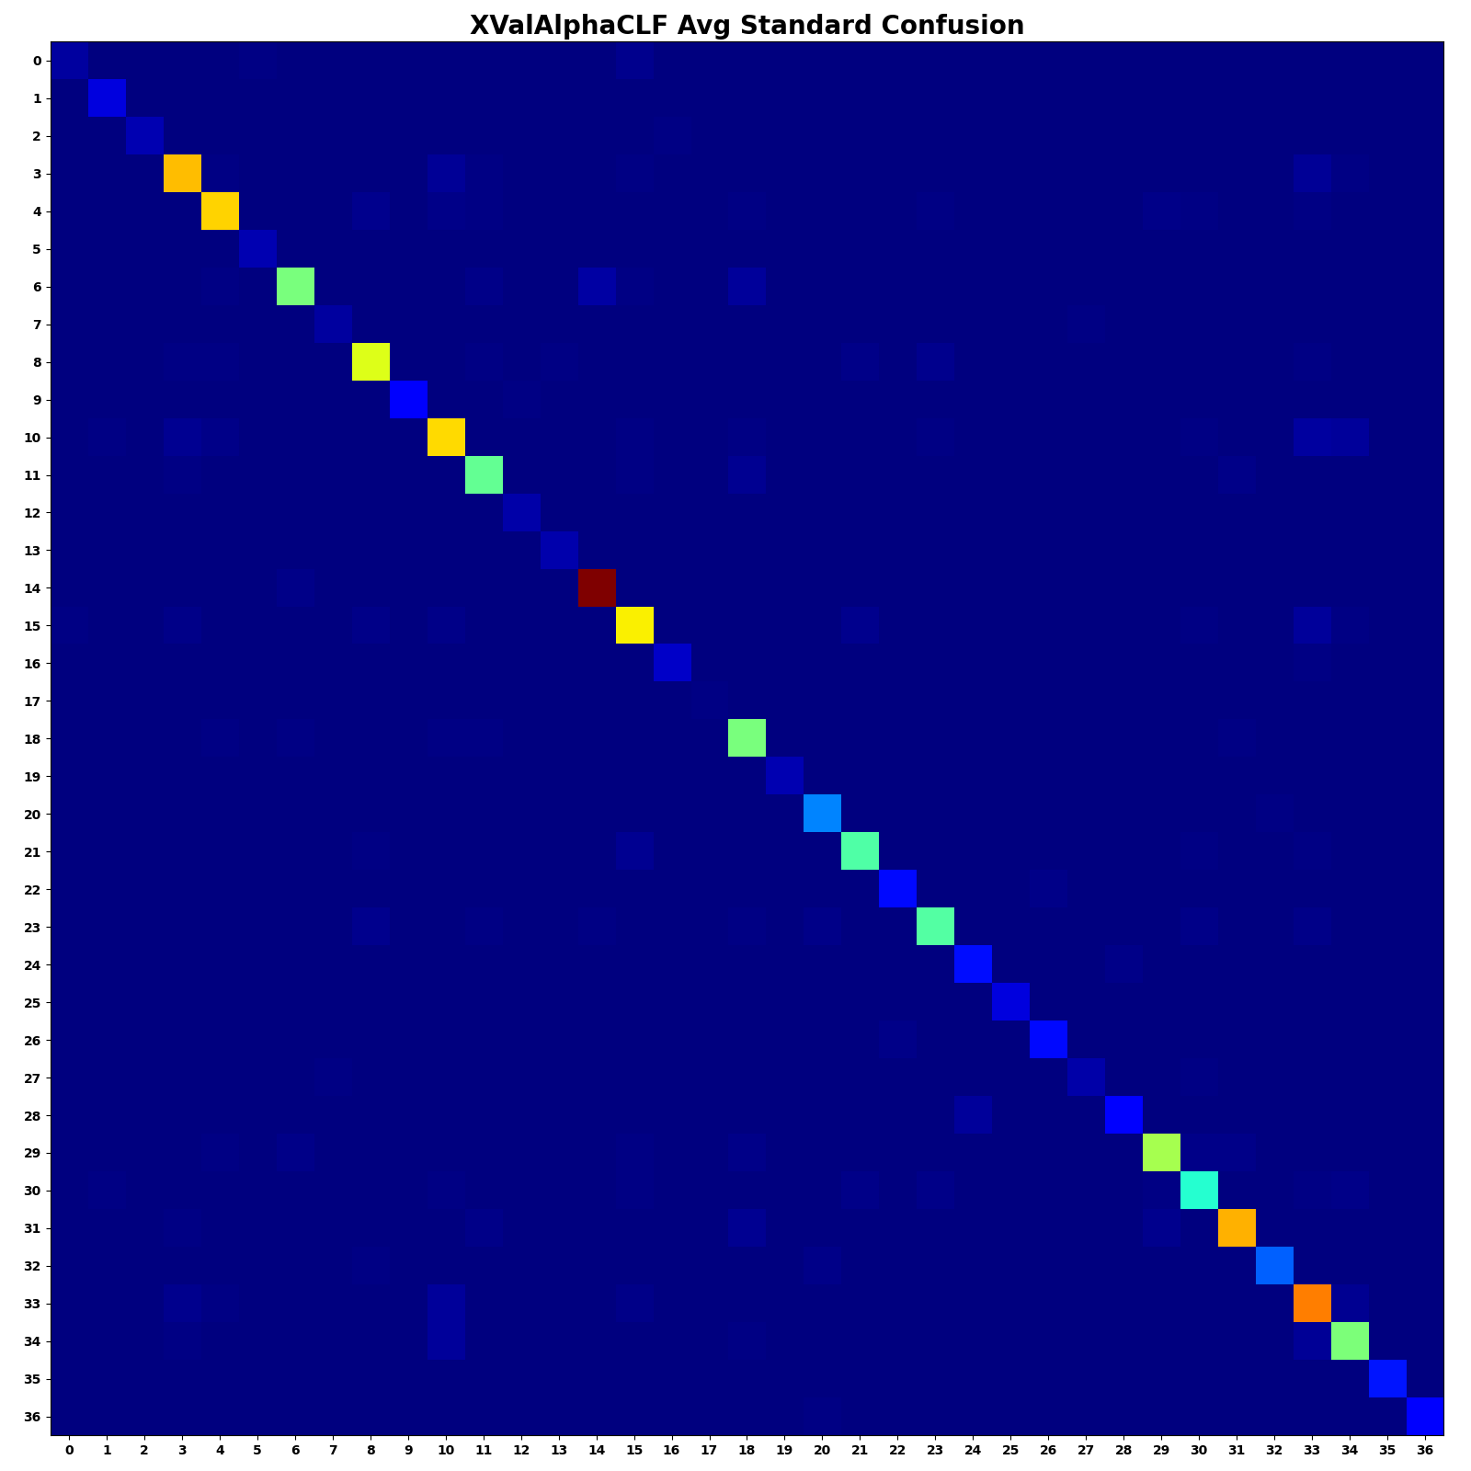
The Standard Confusion Matrix
Averaged over K=10 Folds Cross Validation
Each integer label represents a class
e.g. 10 = Cello, 32 = Vibraphone

Slide 24
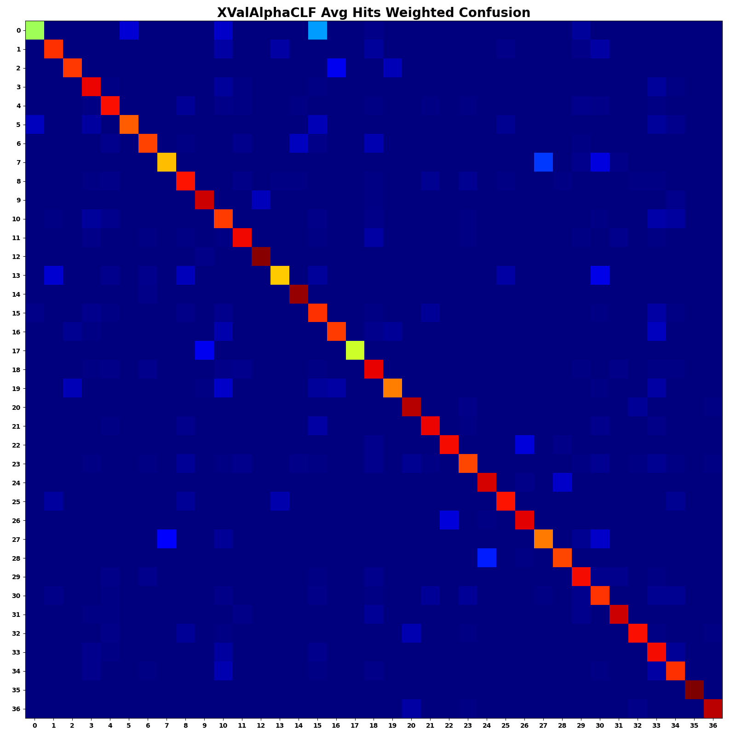
The Hits Weighted Confusion Matrix
Averaged over K=10 Folds Cross Validation
Account for occurrence of each class

Slide 25
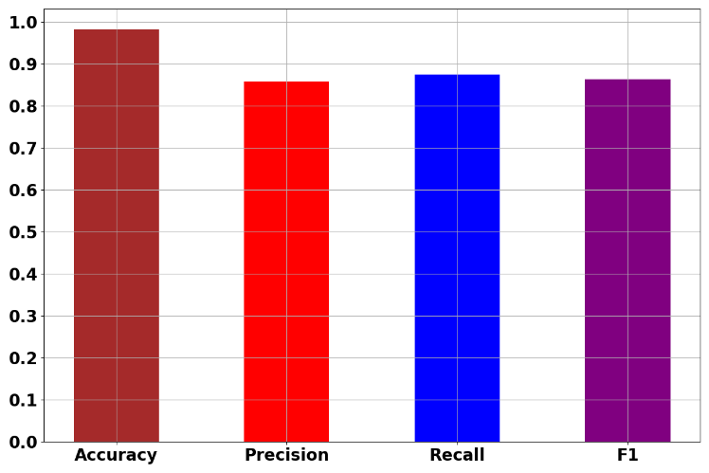


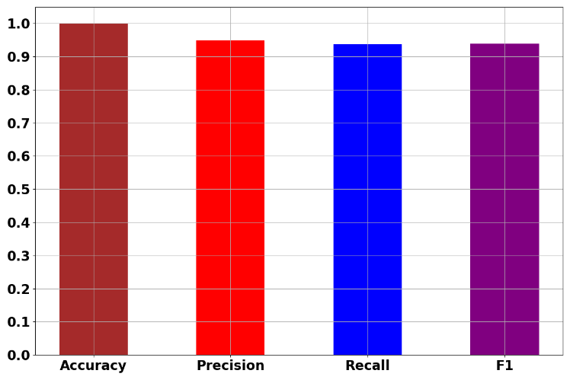
So what?
Flutes
Guitars
When all is said and Done…
Results averaged over 10 folds
Trumpet
Xylophone

Slide 26
Questions?
lhb1007@wildcats.unh.edu

